Slide 1
Siyenza Best Practices
Maria Insua
July 22, 2019

Slide 2
Siyenza Best Practices
What is a Best Practice?
“Best practices” are defined as those practices that, on rigorous evaluation, demonstrate success, have an impact, and can be replicated in other settings.
How do we know if an activity is a Best Practice?
The implementation of the activity have been proven to generate results (measured by the indicators or improved efficiency in the system) and can serve as a model to be learned from and replicated by others.

Slide 3
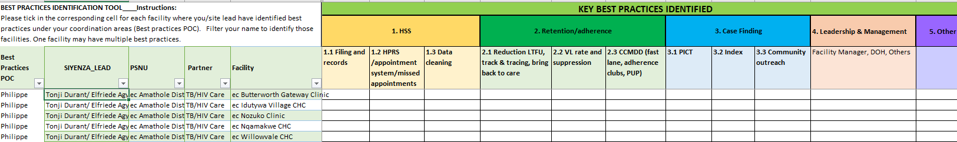
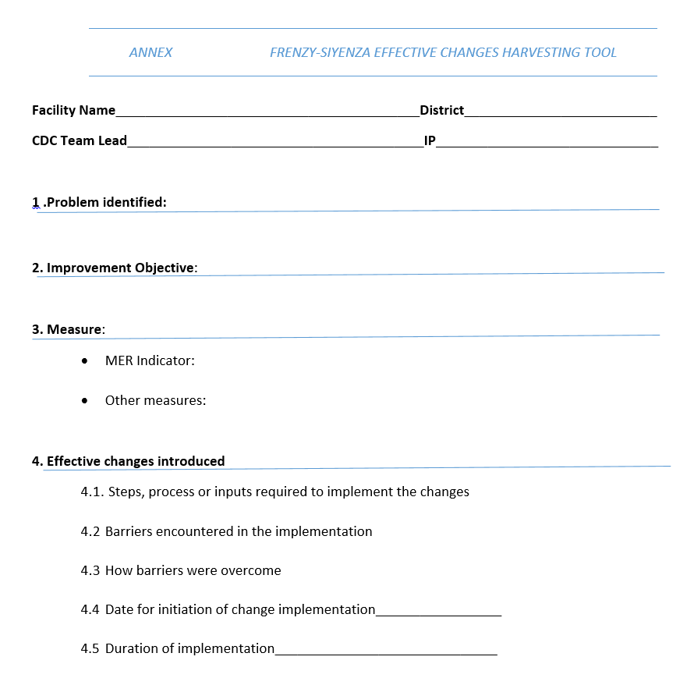
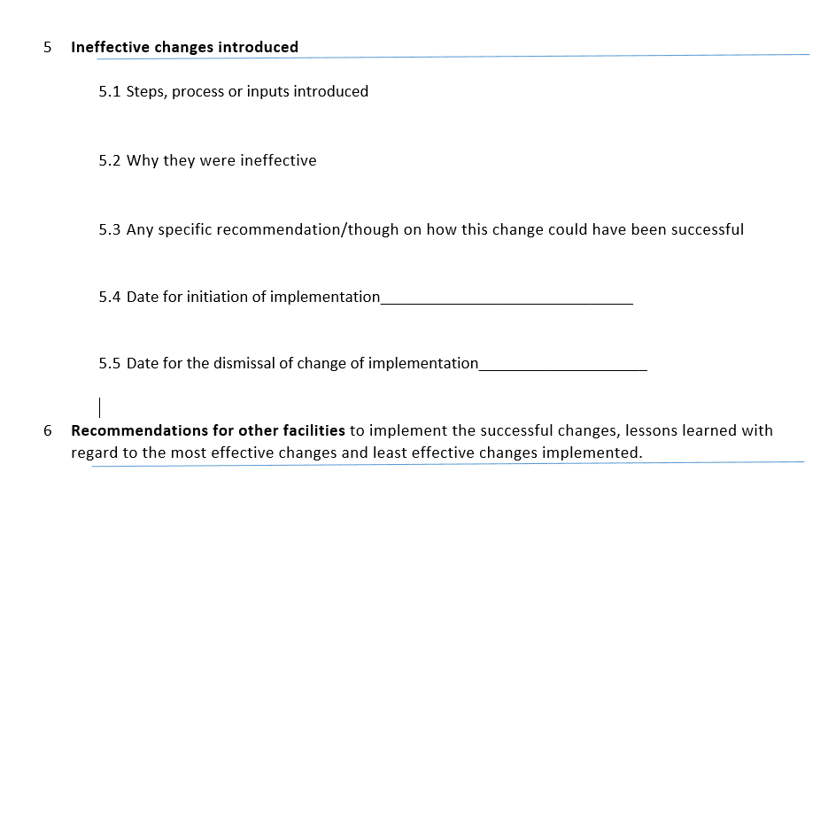
Inventory of best practices identified

Slide 4
FRENZY-SIYENZA EFFECTIVE CHANGES HARVESTING TOOL
Paper based harvesting tool- 2 pages
Identify the problem, the improvement objective and measures for improvement
Identify effective changes or interventions introduced (with implementation steps) and barriers to implement
Identify ineffective changes introduced and reason for failure

Slide 5
Inventory of clinics with Best Practices identified in Key Improvement Areas. N=156 clinics

Slide 6
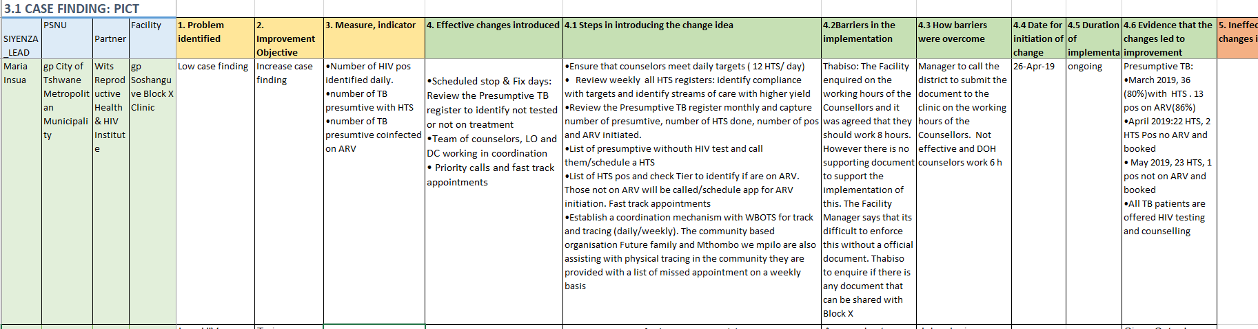
Best Practice captured in the tool

Slide 7
Siyenza Best Practices
Examples from TDY Teams

Slide 8
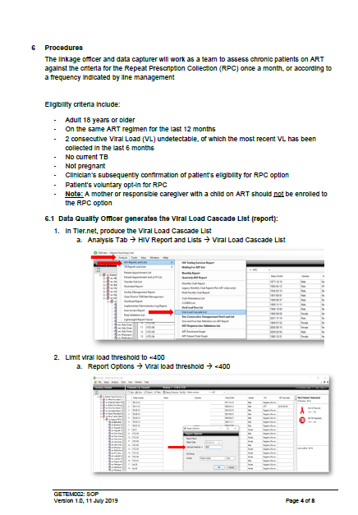
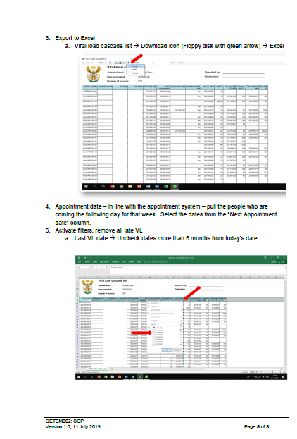
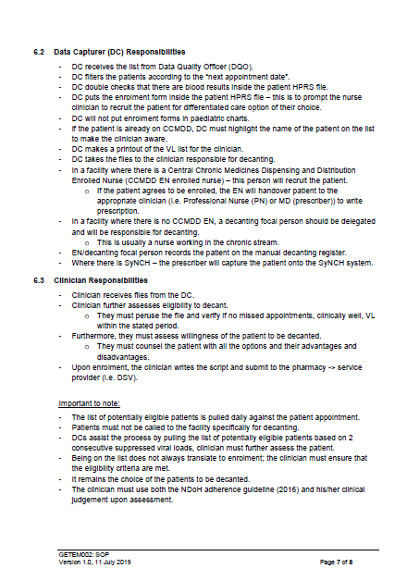
CCMDD/Decanting SOP & Coordinator – TDY Teams 1 and 7
SOP to support the identification of clients eligible for CCMDD/decanting
Decanting Coordinator – team that identified clients for decanting working with a clinician

Slide 9
File Management – TDY Teams 2 and 7
Xhora completed the transition early and reported few issues with missing files.
They do pre-appointment file retrieval, file collection from pharmacy ~ every 2-hours, and capture files throughout the day. DCs know their responsibilities.
THC site coordinator how the team implemented / transitioned to this filing system and data capture processes.
Xhora has a good filing system for the “Missed Appointment” files / records.
Use the plastic boxes and organize the missed appointments by week missed
When a client comes in, they check here as well. We encouraged them to “organize the files w/in the plastic box” by HPRS number and then to keep a printed list of the HPRS numbers w/in the box pasted / taped on the outside – to facilitate location and then removal (mark off file once removed and refiled).
They do not refile “missed appointment files” in the main system each day
They maintain this separate filing system for the 30-day period to facilitate reporting
Pre-retrieval - place files in boxes labeled according to day of appointment.
This saves a lot of time on day of appointment as files have already been pulled out.
At the end of the clinic, all remaining files are handed over to tracers who start contacting patients who have missed a visit the same day.

Slide 10
Linkage, Data Quality, Retention TDY Team 1
"
Linkage
Ensure all in TB case identification reregister , TB presumptive have a documented, recent HIV Status. If HIV positive, ensure system in place to make sure they are ART and follow-up those who are HIV+/not on ART immediately.
Data Quality
Ensure your site has up to date antivirus software and external back up of data.
Asking all clients at reception check-in for their current phone number and address has been helpful in having an up-to-date profile on the clients (Team 7). Also have phone number updated in paper HPRS file by clinician so data capturer can update in tier. DCs must be routinely updating the HPRS paper file number into Tier.net.
Verify everywhere (TDY team 2), registration, consulting rooms, and even adherence club-whoever is leading the adherence club has been instructed to hold onto the list and verify patient contact information before allowing the patient to sign off on the manifest.
Retention
Ensure all NDOH staff have access to Labtrak to track those in on missing and uLTFU lists.

Slide 11
Reduce Silent Transfers, VL – TDY Team 2
Transfer Outs are fast-tracked
1) Asked the curator/person managing the waiting areas to let patients know that if they need to transfer out they will be fast tracked (go straight to registration, DC prints out transfer letter, go straight to consulting room where PN signs off on letter and writes transfer info in patient chart--patient leaves)
2) Put up a sign in the waiting area telling patients that if they need to transfer they will be fast-tracked
3) PNs tell patients during consulting that they will be fast tracked if they ever need to transfer in future
VL
DC flagged charts with due for VL and increased coverage from 30% to 80+%

Slide 12
Retention – TDY Team 4
Tracer at one of our sites has taken it upon himself to call all of the ART patients coming in the next day to remind them of their appointment. This reduces the numbers of missed appointments due to forgetting their appointment

Slide 13
Retention and Linkage – TDY Team 6
Written process for the linkage officer at one of our facilities.
Shared it with other linkage officers. I’m not sure if it is very different from the retention pointers that you have below.
Day -1: Appointment list generated, files are pulled, and bulk SMS reminders sent to entire list
Day 0: (Appointment day) – Files from clients not seen are given to the Linkage Officer
Day 1: All clients who missed appointments the day before are called and outcomes are entered into the missed appointment register (custom printed daily as provided by HST). Files are then returned to the filing room
Day 8: HST generates 8 day missing list and these files are pulled. All clients on this list, are screened for classification errors, and if truly missing, are entered (EM) into the tracing register and a cycle of phone calls/home tracing starts. All clients receive an outcome in the register within 2 weeks.
Day 29: HST generates 29 day missing list and these files are pulled. All clients on this list, are screened for classification errors, and if truly missing, are entered again (LM) into the tracing register and a second cycle of phone calls/home tracing starts. All clients receive an outcome in the register within 1 month.
Day 90: clients still missing will show up on the uLTFU list (from tier.net).
Clients with two prior unsuccessful tracing cycles will be signed off by clinical staff as confirmed LTFU using the documentation in the tracing register.

Slide 14
DQA for Early Missed Visits – TDY Team 7
Mogwase Clinic – Carrying out a DQA for early missed visits.
Going through the files and harmonizing appointment dates in patients’ files and tier.net as these are not harmonized in a number of patients leading to tier.net highlighting patients as lost to follow up when not.
Placed a community health worker in the maternal and child health clinics to pull up files of ART patients who attend these clinics and update their appointment records as it has been observed that some ART mothers receive medications from maternal child health clinics without the files being updated leading to tier.net highlighting these patients as early and late missed visits.

Slide 15
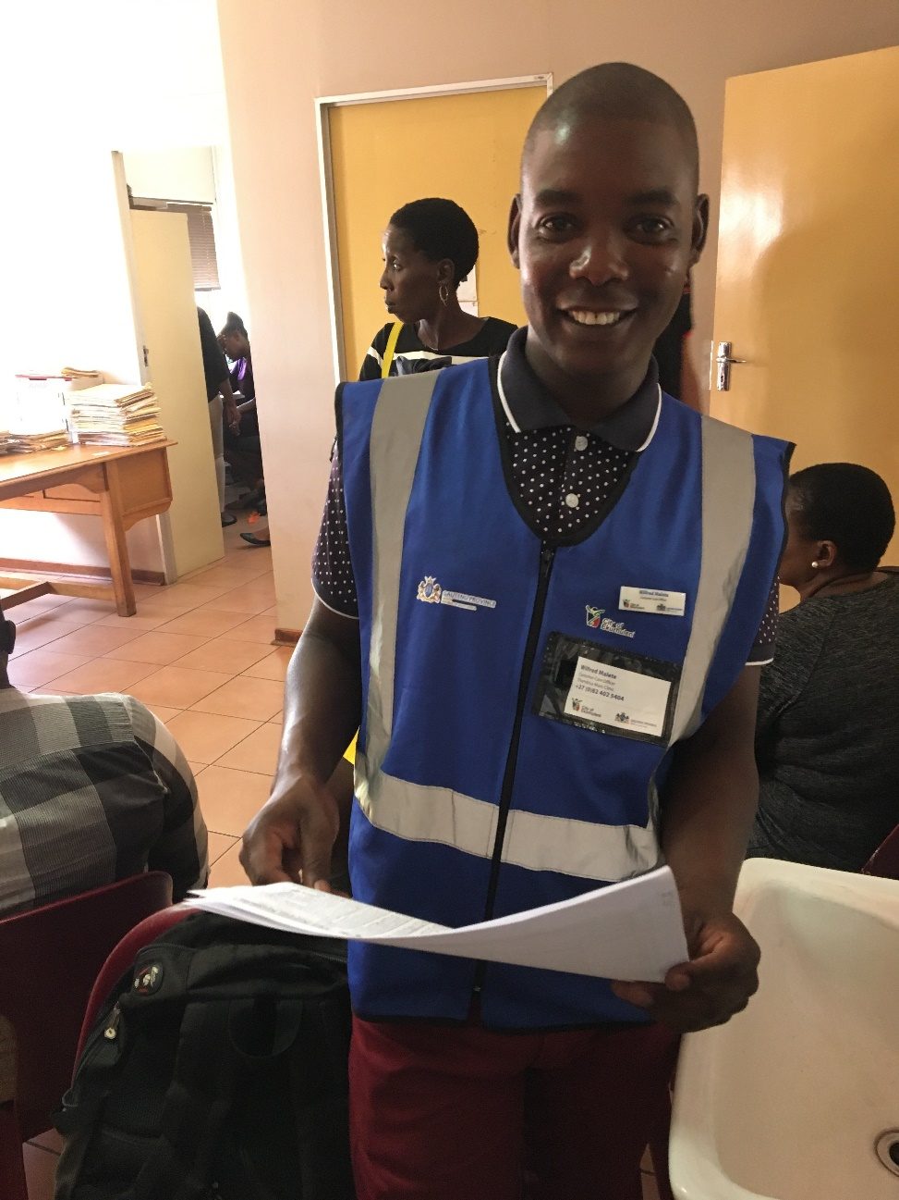
Case Managers – Some DSPs and ICAP QI Project
Hands out business cards to each one of his clients
Has a personal cell dedicated to managing his list of clients
Introduced a “client-center” feel to the care the clinic was providing.
Potential Roles:
Send appointment reminders
Reschedule clinic visits
Follow up missed appointments
Follow up high viral load/missed VL

Slide 16
Your feedback is critical
Siyenza Best Practices
How to identify , report , consolidate and share information?
Prioritize harvesting of Best Practices. Which areas?
How to better support the implementation of Best Practices in non Siyenza facilities (DSP + and TA sites)?
Siyenza operations
What is working?
What should be changed?
Moving forward…
Send to Maria Insua: oej4@cdc.gov

Slide 17
What’s our TOP 10 – recommendations?
What 10 things should every site be doing?
S
S
S
S
S
S
S
S
S
s

